Slide 1

Find a Career in Dental Hygiene
Presenter name

Slide 2
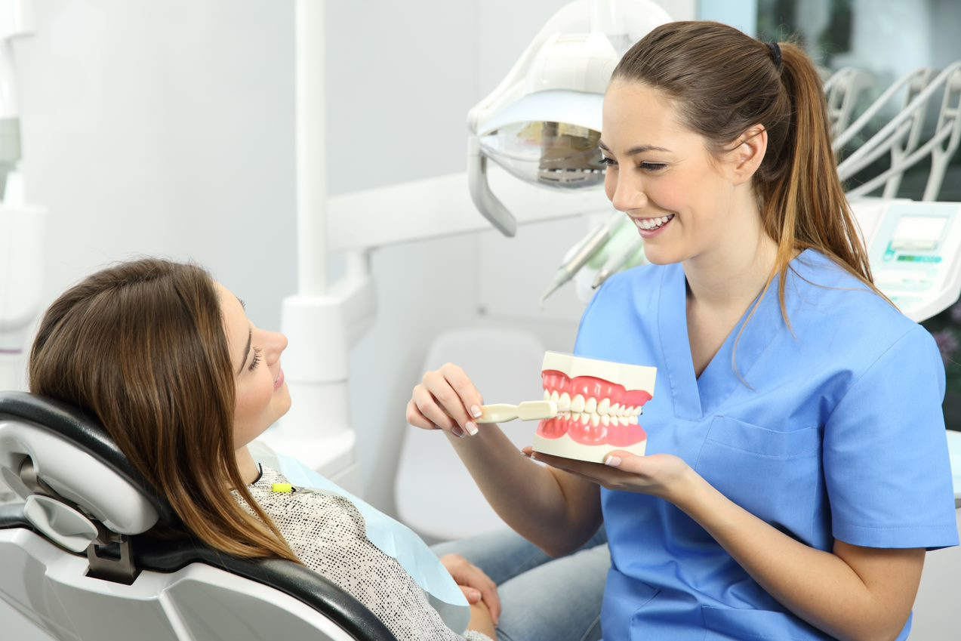

What is a Dental Hygienist ?
Dental hygienists work with the dentist to meet patients’ oral health needs.
Notes:
What is a Dental Hygienist?
A Dental Hygienist is an important part of your dental team. Hygienists are dental professionals who have completed training at an accredited college, graduated with at least an associate degree, have passed both written national boards & clinical regional boards, and have obtained state licensure to practice.
Dental hygienists work with the dentist to meet patient’s oral health needs.
-Screening patients, reviewing health histories, performing oral cancer screenings
-Cleaning teeth
-Applying sealants and fluoride to protect tooth surfaces
-Educating patients about proper oral hygiene and how their diets affect their oral health
Charting treatment performed on each patient
Watch video is time allows. https://youtu.be/4SKiWwepNDo (Video is about 7 minutes long)
ADA Dental Careers FORM (nddental.org)

Slide 3
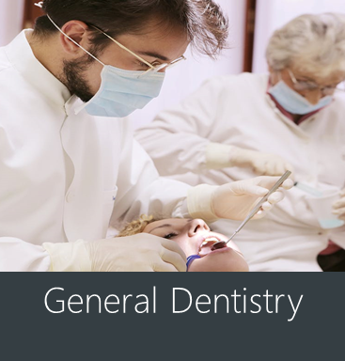
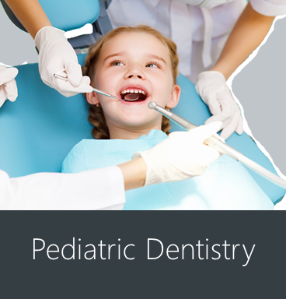

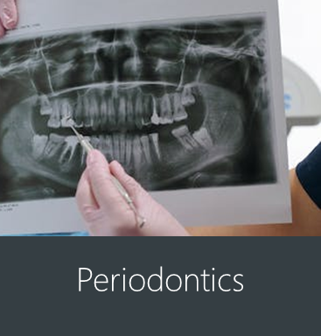
Dental Fields in
Dental Hygiene
There are many specialty branches of dentistry, but not all of them utilize a dental hygienist in the office.
Notes:
General Dentistry: Dentistry works with oral health at every stage of life from children to elderly adults. Comprehensive oral care is given from baby teeth to permanent teeth.
Pediatric: The branch of dentistry working with the oral health of children from birth to adolescence.
Periodontics (Gums): The branch of dentistry that works with the structures that surround and support your teeth.
Dental Public Health: Involves a para-clinical specialty of dentistry that deals with the prevention of oral disease and promotion of oral health.
North Dakota employs PHH/RDH (public health hygienist, dental hygienist) for public health programs such as SEAL!ND School-based program and more.
Dental practices that do not utilize a dental hygienist
Orthodontics (braces): The branch of dentistry that works focuses on the treatment of malocclusion.
-a dental hygienist is usually not a team member in this clinic. Dental hygiene services are referred to other offices.
Endodontics/Root Canals: The branch of dentistry that treats the inside of the tooth
-a dental hygienist is usually not a team member in this clinic. Dental hygiene services are referred to other offices.
Prosthodontics (prosthetic/artificial-like dentures): The branch of dentistry that focuses on prosthetic dentistry.
-a dental hygienist is usually not a team member in this clinic. Dental hygiene services are referred to other offices.

Slide 4

General Responsibilities of a Dental Hygienist
Removing plaque, calculus and stains
Exposing and processing dental X-rays
Applying cavity-preventive agents
Administering antimicrobial agents
Administering local anesthetic
Providing clinical and laboratory diagnostic tests
Taking patients complete medical history and interpreting it
Notes:
General responsibilities of a Dental Hygienist
Here is a general idea of the duties a dental hygienist can do, but it depends on the agreement with the dentist you are working under.
Removing plaque, calculus, and stains from the teeth.
Exposing and processing dental X-rays.
Applying cavity-preventive agents, such as fluorides and pit and fissure sealants.
Administering antimicrobial agents.
Administering local anesthetic.
Providing clinical and laboratory diagnostic tests for interpretation by other health professionals.
Taking the patient’s complete medical history and interpreting it.

Slide 5

Is dental Hygiene right for me?
If you are detail oriented, organized, a multitasker who can work independently and enjoys helping others, explore your options as a dental hygienist.
Notes:
Is dental hygiene right for me?
If you are detail oriented, organized, a multitasker who can work independently and enjoys helping others, explore your options as a dental hygienist.

Slide 6
How are they different?
Dental Hygienist
Dental Assistant
Clean teeth
Provide education
Help dentist find cavities
Roughly 3 years of school after graduating high school (or a GED)
Take dental X rays
Hand instruments to the dentist
Organize the dental treatment rooms
Can be trained by a dentist in the dental office
Can earn a certificate or an associates degree
Roughly 2 years of schooling after high school (or GED)
If you're thinking about being part of the dental profession, congratulations!
We need dedicated professionals.
Notes:
How are they different?
Dental Hygienist
Clean teeth
Provide education
Help dentist find cavities
Roughly 3 years of school after graduating high school (or a GED)
Dental Assistant
Take dental X rays
Hand instruments to the dentist
Organize the dental treatment rooms
Can be trained by a dentist in the dental office
Can earn a certificate or an associates degree
Roughly 2 years of schooling after high school (or GED)
If you're thinking about being part of the dental profession, Congratulations!
We need dedicated professionals

Slide 7
Timeline To Be a Dental Hygienist
Complete high school or earn a GED
Begin practice
Associate’s degree in Dental Hygiene
(2 years)
Bachelor’s degree in Dental Hygiene
(4-years)
Apply for a Dental Hygiene program
Notes:
Timeline in High School and After
Complete high school or earn a GED
Apply for a Dental Hygiene program
Associate’s degree (2 years)
Bachelor’s degree in Dental Hygiene (4 years)
Begin practice

Slide 8

Cost To Go To College
American Dental Education Association
North Dakota Example from NDSCS
Average tuition and fees for in-state DH schools:
$22,692 for an Associate degree
$36,382 for a Bachelor's degree
$30,421 for a Master's degree
Associates of Applied Science in Dental Hygiene is about $44,000 including the dining and living plans.
Based on information from the North Dakota State College of Science.
Notes:
According to the American Dental Education Association (ADEA), the average tuition costs and fees for in-state dental hygiene schools are $22,692 for an Associate degree. $36,382 for a Bachelor's degree. $30,421 for a Master's degree
Cost of Dental School
Example**
Based on information from the North Dakota State College of Science.
Associates of Applied Science in Dental Hygiene is about $44,000 including the dining and living plans.
Wahpeton - Dental Hygiene.pdf (ndscs.edu)

Slide 9

North Dakota Employment and Salary
Average beginning monthly salary: $5,583
High monthly salary: $7,800 ($93,600 annually)
Placement: 100%
National Averages for Employment and Salary
Average salary: $81,360
16,300 job openings nationally
Notes:
Https://www.ndscs.edu/academics/academic-departments-programs/dental-assisting-hygiene
Is-DA-right-for-me-FLYER.pdf

Slide 10



School Choices
List of some in North Dakota
North Dakota State
College of Science
Wahpeton, ND
Bismarck State College
Bismarck, ND
*Starting Fall of 2025*
Dakota College at Bottineau
Bottineau, ND
*Starting Fall of 2025*
Notes:
*If someone would ask about schools outside of North Dakota……..
Minnesota Programs South Dakota Montana
Century College, White Bear Lake Lake Area Technical College, Watertown *Starting Fall of 2025* Montana State University, Great Falls
Herzing University, St. Louis Park University of South Dakota, Vermillion
Lake Superior College, Duluth
Minnesota State University, Mankato
Metropolitan State University, St. Paul
University of Minnesota, Minneapolis
St. Cloud Technical College, St. Cloud
Rochester Community and Technical College, Rochester
Normandale Community College, Bloomington
Minnesota State Community and Technical College, Moorhead
Northwest Technical College, Bemidji

Slide 11

My Story:
Why I Chose Dental Hygiene
Notes:
Add your own photo of you and or your practice

Slide 12

Activity
Notes:
Choose an activity from (add link to website here activities are listed, and checkout form is found)

