Slide 1
Find a Career in Dental Assisting
Presenter name
Notes:
Agenda:
What is a dental assistant?
How are they different?
Many Dental Specialties
Is Dental Assisting Right for me?
How are They Different?
Timeline To Be a Dental Assistant
Pathways To Become a Registered Dental Assistant in North Dakota
Cost of Schooling
Employment
School Choices
Activity

Slide 2
What is a Dental Assistant?
Dental assistants are valued team members who help provide patient care and keep dental practices running efficiently
Notes:
what is a dental assistant?
Dental assistants are valued team members who help provide patient care and keep dental
practices running efficiently.
Assist the dentist during procedures
Take X-rays and/or impressions of patients’ teeth
Sterilize equipment and instruments
Teach patients to brush and floss correctly
Schedule appointments, maintaining inventories and ordering supplies
Dental assisting duties can very depending on the dental office's specialties.
Watch video if time allows. https://youtu.be/Kd0vC3beboo (video is about 5 minutes long)
ADA Dental Careers FORM (nddental.org)

Slide 3
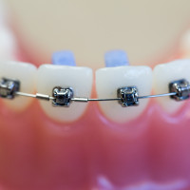
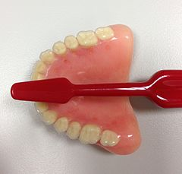
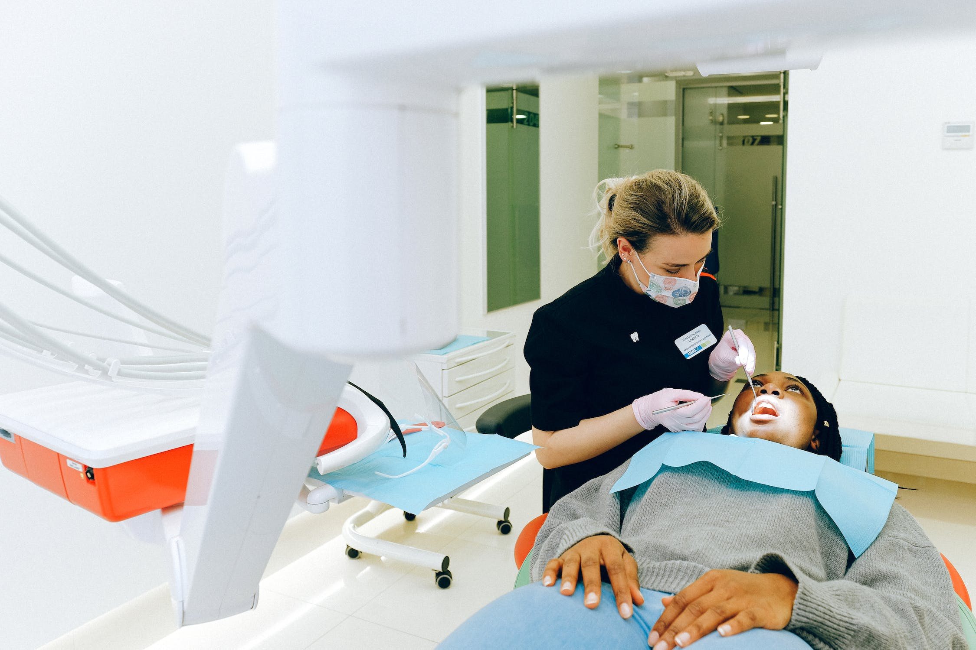
The Many Dental Fields
Pediatric Dentistry
Orthodontics
Oral Surgery
Prosthodontics
Endodontics
Dental Public Health
Notes:
General Dentistry: Dentistry working with oral health at every stage of life from children to elderly adults. Comprehensive oral care is given from baby teeth to permanent teeth.
Pediatric: The branch of dentistry working with the oral health of children from birth to adolescence.
Orthodontics (braces): The branch of dentistry that works focuses on treatment of malocclusion.
Periodontics (gums): The branch of dentistry that works with the structures that surround and support your teeth.
Oral Surgery: The branch of dentistry that works with the diagnosis and the surgical and adjunctive treatment of diseases, injuries, and defects of the human mouth and dental structures.
Prosthodontics(prosthetic/artificial like dentures): The branch of dentistry that focuses on prosthetic dentistry.
Endodontics/Root Canals: The branch of dentistry that treats the inside of the tooth
Dental Public Health: Involves a para-clinical specialty of dentistry that deals with the prevention of oral disease and promotion of oral health.

Slide 4
Is dental assisting right for me?
If you are detail oriented, organized, a multitasker who can work independently and as a team while enjoying helping others, consider a career in dental assisting.
Notes:
Is dental Assisting right for me?
If you are detail oriented, organized, a multitasker who can work independently and as a team while enjoying helping others, consider a career in dental assisting.

Slide 5
How are they different?
Dental Hygienist
Dental Assistant
Clean teeth
Take dental X rays
Provide patient education
Help dentist find cavities
Roughly 3 years of school after graduating high school (or a GED)
Take dental X rays
Hand instruments to the dentist
Organize the dental treatment rooms
Can be trained by a dentist in the dental office
Can earn a certificate or an associates degree
Roughly 2 years of schooling after high school (or a GED)
If you're thinking about being part of the dental profession, congratulations!
We need dedicated professionals.
Notes:
How are they different?
Dental Hygienist
Clean teeth
Take dental X rays
Provide patient education
Help dentist find cavities
Roughly 3 years of school after graduating high school (or a GED)
Dental Assistant
Take dental X rays
Hand instruments to the dentist and organize the dental treatment rooms
Organize the dental treatment rooms
Can be trained by a dentist in the dental office
Can earn a certificate or an associates degree
Roughly 2 years of schooling after high school (or a GED)
If you're thinking about being part of the dental profession, Congratulations!
We need dedicated professionals

Slide 6
Timeline To Be a Dental Assistant
Complete high school or GED
Begin practice
Complete Associates degree or Dental Assistant certificate program
(roughly 2 years)
Apply for Dental Assisting program, or find a practice to do on the job training
Notes:
Timeline to Be a Dental Assistant
Complete high school or GED
Apply for Dental Assisting Program, or find a practice to do on the job training
Complete Associates of Applied Science Degree in Dental Assisting or Dental Assisting certification program (roughly 2 years)
Begin practicing
NDSCS Dental Assisting Program Information-Selection Process Booklet Fall 2022.pdf

Slide 7
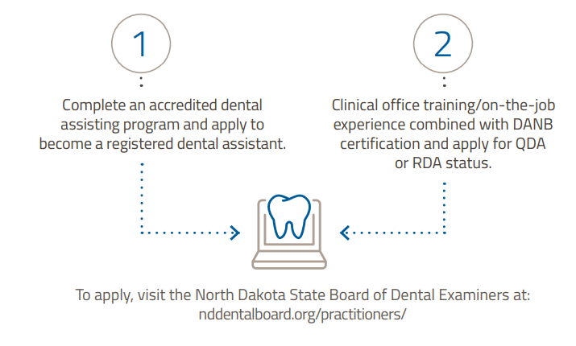
Two Pathways To Become a Registered Dental Assistant
in North Dakota
Notes:
Your-Path-to-Dental-Assistant-Registration-in-North-Dakota.pdf
Is-DA-right-for-me-FLYER.pdf

Slide 8
Cost To Go To College
Average Expenses without Living & Dining
North Dakota Example from NDSCS
Associates degree in DA is $27,000 with dining and living plans.
Dental Assisting certificate about $22,000 with dining and living plans.
Based on information from North Dakota State College of Science.
Associate's degree ranges from $6,000 -$30,000.
A DA diploma or certification ranges between $3,000 - $15,000.
Notes:
https://climbcredit.com/resources/healthcare/how-much-does-dental-assistant-school-cost/#:~:text=While%20the%20cost%20of%20an,technical%20schools%20and%20community%20colleges
While the cost of an associate’s degree in dental assisting typically ranges from $6,000–30,000, a dental assistant diploma or certification only costs on average between $3,000–15,000 and can be found at many technical schools and community colleges. For both of these programs, however, you’ll also want to consider additional costs that may be required, such as:
Registration fees
Certification exam fees
Lab fees
Books and supplies
Whether you attend a degree program or a diploma program will also affect how much time you’ll ultimately invest. For example, an associate’s degree takes two years to complete — on the other hand, a certificate program takes considerably less at less than 12 months. Length can also be impacted by other factors such as whether you’re in a full-time or part-time program, and whether you’re pursuing any additional specializations.
Cost of Dental School
Example**
Based on information from North Dakota State School of Science.
Wahpeton - Dental Assisting.pdf (ndscs.edu)

Slide 9
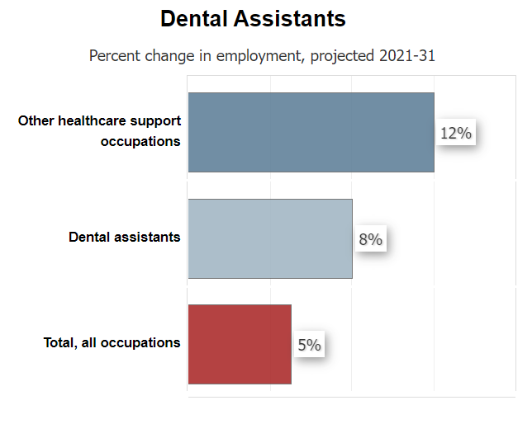
Employment
Employment of dental assistants is projected to grow 8% from 2021 to 2031, faster than the average for all occupations.
Notes:
Dental Assistants : Occupational Outlook Handbook: : U.S. Bureau of Labor Statistics (bls.gov)
Employment of dental assistants is projected to grow 8 percent from 2021 to 2031, faster than the average for all occupations.
About 56,400 openings for dental assistants are projected each year, on average, over the decade. Many of those openings are expected to result from the need to replace workers who transfer to different occupations or exit the labor force, such as to retire.

Slide 10
nddental.org/bright-futures-in-dentistry-careers/
Notes:
https://nddental.org/bright-futures-in-dentistry-careers/

Slide 11
North Dakota Employment and Salary
Average beginning monthly salary: $3,706
High monthly salary: $4,333
Placement: 100%
National Averages for Employment and Salary
Average salary: $38,660
56,400 job openings nationally
Notes:
Https://www.ndscs.edu/academics/academic-departments-programs/dental-assisting-hygiene
Is-DA-right-for-me-FLYER.pdf

Slide 12
School Choices List of some in near North Dakota
North Dakota State
College of Science
Wahpeton, ND
Bismarck State College
Bismarck, ND
*Starting Fall of 2025*
Dakota College at Bottineau
Bottineau, ND
*Starting Fall of 2024*
Notes:
Dental Assistant | Minnesota Dental Association (mndental.org)
*If someone would ask about schools outside of North Dakota……..
Minnesota Programs South Dakota Montana
Century College, White Bear Lake Lake Area Technical College, Watertown Montana State University, Great Falls
Herzing University, St. Louis Park University of South Dakota, Vermillion Salish Kootenai College, Pablo
Lake Superior College, Duluth Western Dakota Tech. Institute, Rapid City Flathead Valley Community College, Kalispell
Minnesota State University, Mankato Helena College University of Montana, Helena
Metropolitan State University, St. Paul Montana State University, Billing
University of Minnesota, Minneapolis Miles Community College, Miles
St. Cloud Technical College, St. Cloud
Rochester Community and Technical College, Rochester
Normandale Community College, Bloomington
Minnesota State Community and Technical College, Moorhead
Northwest Technical College, Bemidji

Slide 13
My Story: Why I Chose Dental Assisting
Notes:
Add your own photo of you and or your practice

Slide 14
Activity
Notes:
Choose an activity from (add link to website here activities are listed, and checkout form is found)

