Slide 1

Finding your career in Dentistry
Presenter name
Notes:
Agenda:
What is dentistry?
Many Dental Specialties
How are they different?
What now?
School Choices
Timeline to becoming a dentist
The Finance of Dentistry
How dentists pay for dental schooling
ND loan repayment programs
The finance of dentistry
Role Model
My Story
Activity

Slide 2
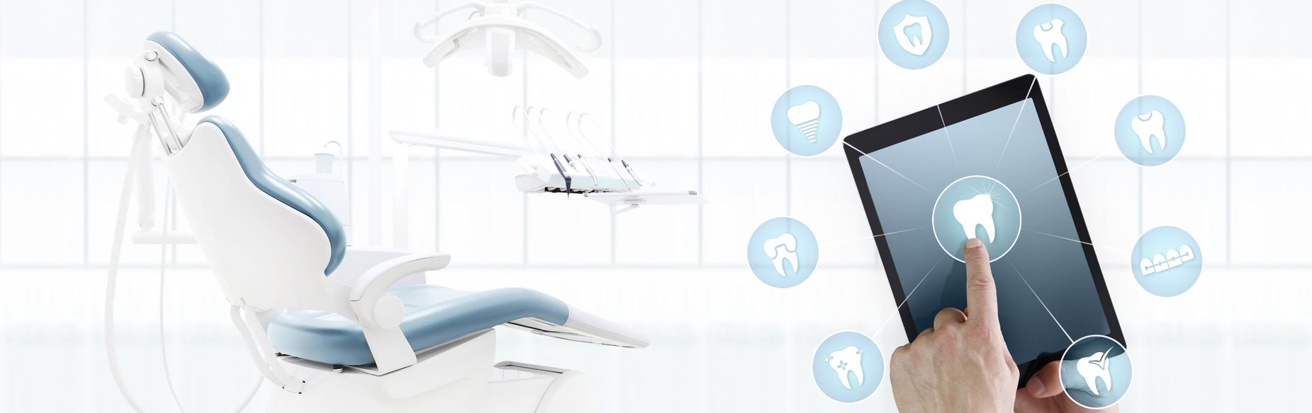
What is dentistry?
Notes:
Dentistry, can also be recognized as dental medicine and oral medicine. It is the branch of medicine focused on the teeth, gums, and the mouth.
Being a dental professional has lots of rewards and challenges as well as opportunities to make a difference in peoples lives and your community.
While this presentation we will primarily focus on becoming a dentist however there are other dental professions that will be mentioned during this presentation that you may want to consider.
Watch video if time allows. https://youtu.be/4htt3_zeGLQ (Video if about 6 minutes long)

Slide 3

What Is a dentist?
Dentists diagnose and treat problems with patients’ teeth, gums, and parts of the mouth.
Restore oral health and transform the lives of your patients
Be a business owner and independent in your career
Earn a good salary
Be creative with your hands
Maintain a flexible lifestyle
Shape the future of oral healthcare
Choose from several career specialties
Be respected members of the community
Work as part of a healthcare team
Notes:
What is a dentist?
Dentists diagnose and treat problems with patients’ teeth, gums, and parts of the mouth
Restore oral health and transform the lives of your patients
Be a business owner and independent in your career
Earn a good salary
Be creative with your hands
Maintain a flexible lifestyle
Shape the future of oral healthcare
Choose from several career specialties
Be respected members of the community
Work as part of a healthcare team
Dentists diagnose and treat problems with patients’ teeth, gums, and related parts of the mouth
Future Dentists (adea.org)

Slide 4
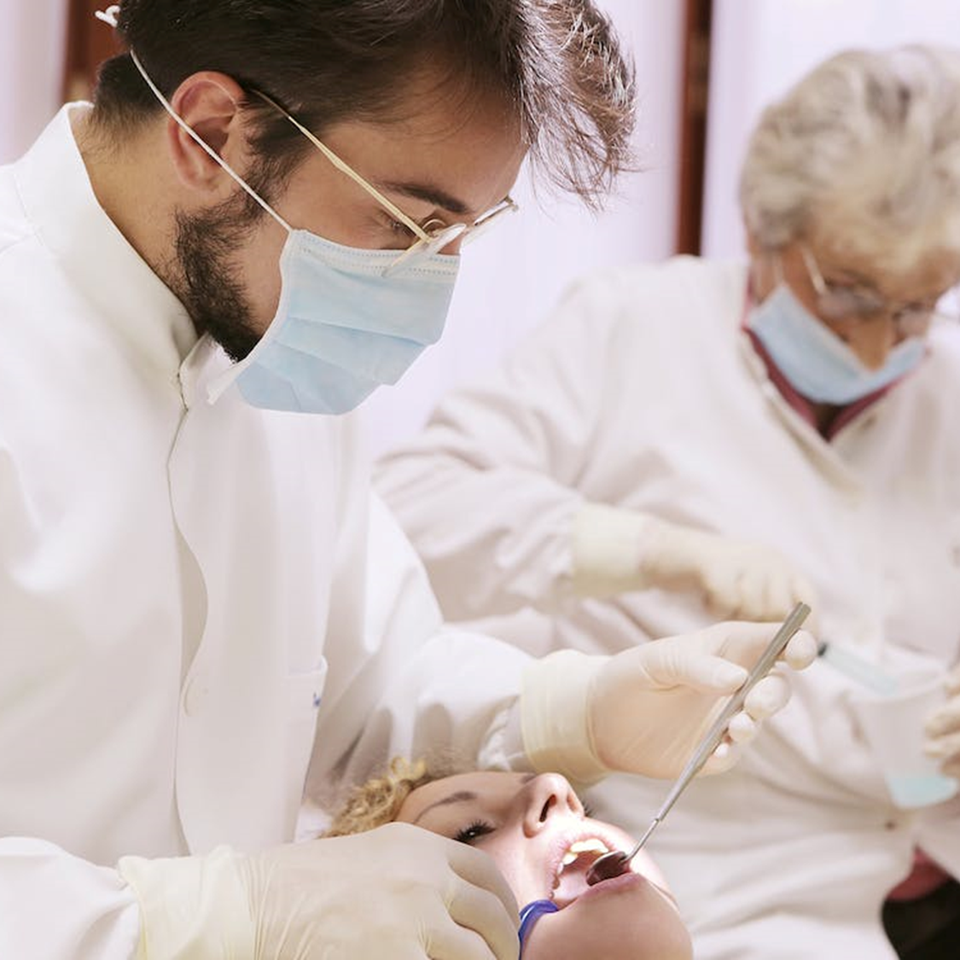

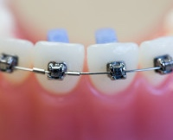
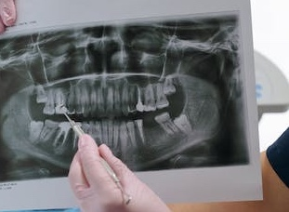
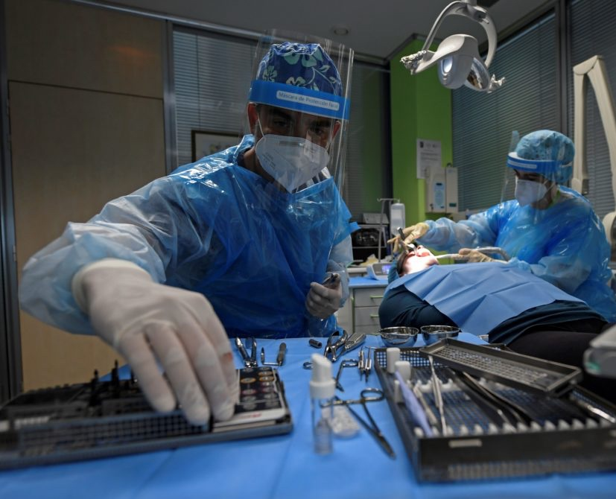
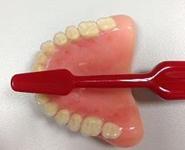
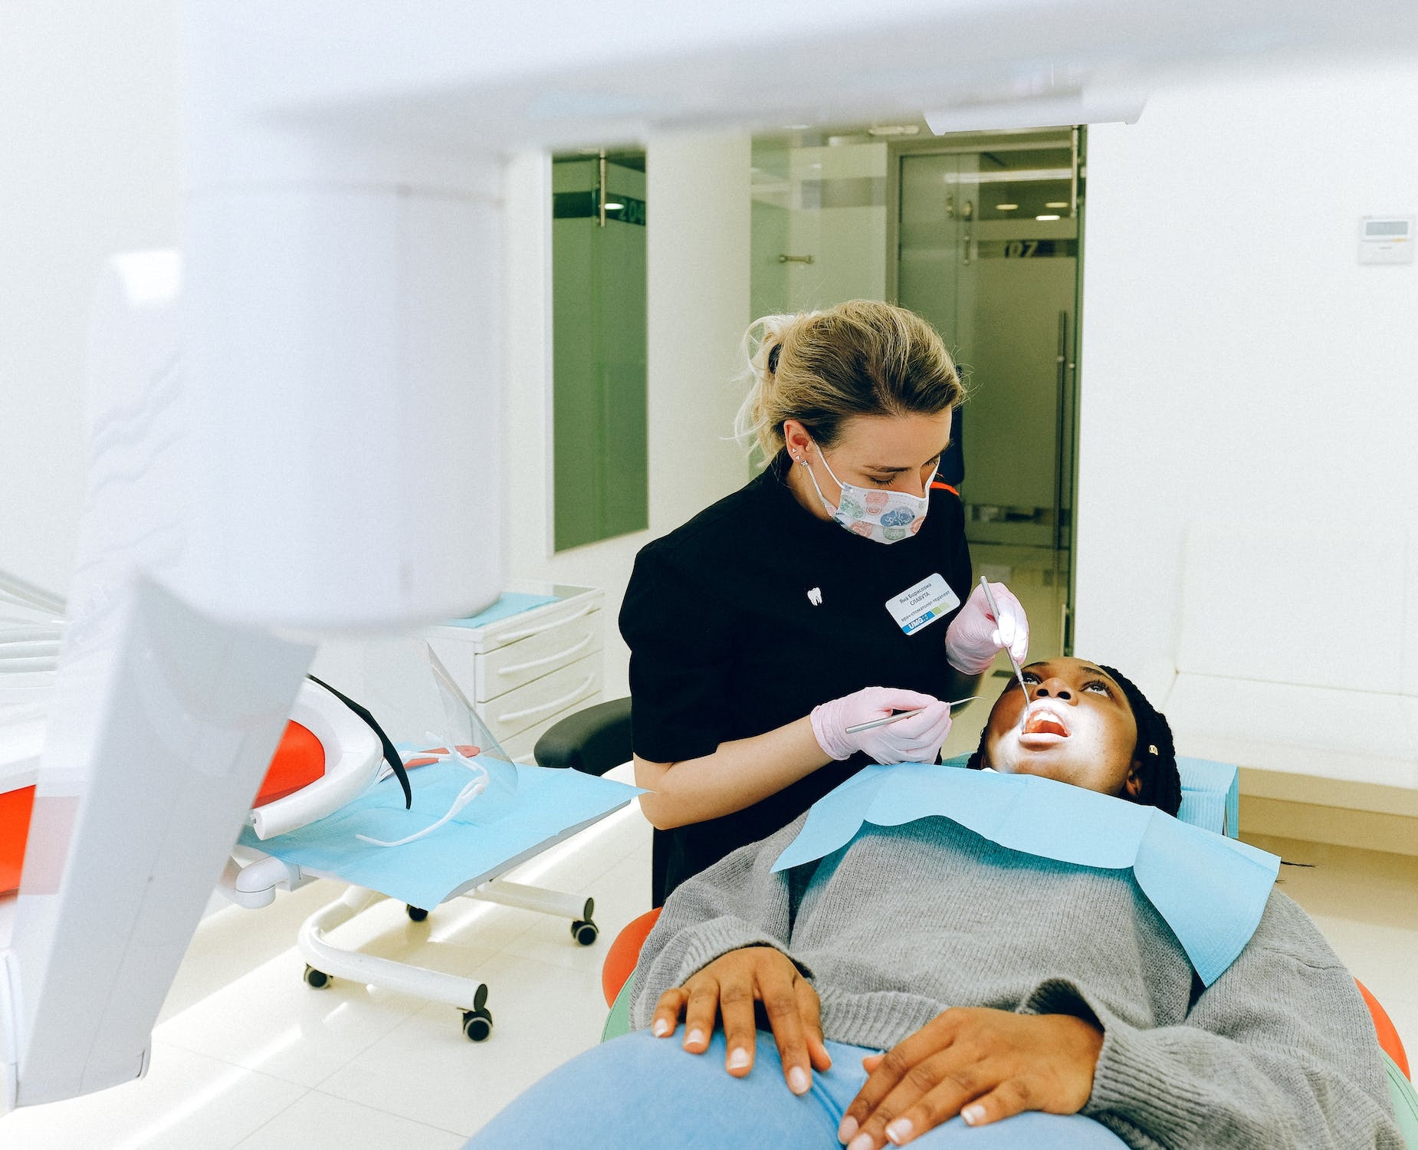

The Many Dental Fields
General Dentistry
Pediatric Dentistry
Orthodontics
Periodontics​
Oral Surgery
Prosthodontics
Endodontics
Dental Public Health
Notes:
General Dentistry: Dentistry working with oral health at every stage of life from children to elderly adults. Comprehensive oral care is given from baby teeth to permanent teeth.
Pediatric: The branch of dentistry working with the oral health of children from birth to adolescence.
Orthodontics (braces): The branch of dentistry that works focuses on treatment of malocclusion.
Periodontics (gums): The branch of dentistry that works with the structures that surround and support your teeth.
Oral Surgery: The branch of dentistry that works with the diagnosis and the surgical and adjunctive treatment of diseases, injuries, and defects of the human mouth and dental structures.
Prosthodontics(prosthetic/artificial like dentures): The branch of dentistry that focuses on prosthetic dentistry.
Endodontics/Root Canals: The branch of dentistry that treats the inside of the tooth
Dental Public Health: Involves a para-clinical specialty of dentistry that deals with the prevention of oral disease and promotion of oral health.

Slide 5
How are they different?
Dentist
Dental Hygienist
Dental Assistant
Treat dental diseases
Fill cavities and extract teeth
Make dentures, straighten teeth
Roughly 4 years of school after graduating from a 4-year college; specialization may require additional schooling
No clinical residency after graduation
Clean teeth
Take dental X rays
Provide patient education
Help dentist find cavities
Roughly 3 years of school after graduating high school (or a GED)
Take dental X rays
Hand instruments to the dentist
Organize the dental treatment rooms
Can be trained by a dentist in the dental office
Can earn a certificate or an associates of applied science degree
Roughly 2 years of schooling after high school
Notes:
How are they different?
Dentist
These are some of the duties of a dentist that can be done.
treat dental diseases by filling cavities and extracting teeth Dentists also make dentures and some dentists straighten teeth that are crooked
Schooling can take years after college 3-4
If you choose to specialize in an area of dentistry, you require a rang of additional training per your specialty choice.
Dental Hygienist
These are some of the duties of a dental hygienist that can be done.
Take dental x rays
Clean teeth with special instruments
Provide Patient education
Help the dentists find cavities
Schooling can take 2-3 years after high school
Dental Assisting
These are some of the duties of a dental assistant that can be done.
Take dental X rays
Hand instruments to the dentist and organize the dental treatment rooms
Organize the dental treatment rooms
Can be trained by a dentist in the dental office
Can earn a certificate or an associates of applied science degree
Roughly 2 years of schooling after high school

Slide 6

How can you plan and prepare?
Talk to your school guidance counselor
Take classes in math and science
Maintain good grades
Develop hobbies that have you working/creating things with your hands
Develop a curiosity about what causes disease and how cures are developed
Shadow at a local dental office
Take part in Future Health Professionals
Take opportunities for leadership
Join student organizations
All Dental Careers Involve Life-Long Learning!
Notes:
What Now
Talk to your school guidance councilor
Take Classes in Math and Science
Biology, Chemistry, Trigonometry, Algebra, Calculus
Develop Hobbies that have you working/creating things with your hands!
Painting, Wood Working, Pottery/Ceramics Knitting and Embroidery, Learning an Instrument
Develop a curiosity about what causes disease and how cures are developed
Shadow at a local dental office
Take part in Future Health Professionals
Learn about populations by learning another language, studying art history, and reading books by great writers!
Take opportunities for leadership
Join student organizations
All Dental Careers Involve Life-Long Learning!

Slide 7
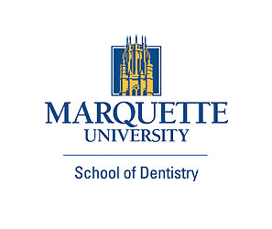



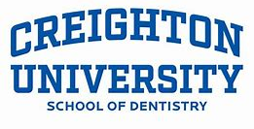
School Choices
List of some near North Dakota
University of Nebraska Lincoln, NE
Marquette University Milwaukee, WI
University of Iowa Iowa City, IA
University of Minnesota Minneapolis, MN
Creighton University Omaha, NE
Notes:
Here are some school choices if you are in living in North Dakota and are interested in becoming a dentist.

Slide 8
Timeline to Becoming a Dentist
Four-year college degree
Take the Dental Admissions Test (DAT)
Apply for dental school
High school diploma and college entrance exams
Interviews and admission applications
Dental School Completed
Roughly 4 years
Notes:
High School, SAT or ACT Exam-Keep a strong GPA. Take a SAT or SAT test.
4yrs Undergraduate and/or Graduate Collage degree
November-December
-Follow re-requisites courses for dental school.
January-March
-Obtain a pre-health committee letter
April-June
-Register for DAT found on ADA website
Take DAT
July –September
Gather in formation about dental schools.
-The ADEA Dental School Explorer is updated each spring and is available for purchase at the ADEA website
ADEA Dental School Explorer is updated each spring and is available for purchase at the ADEA
site: https://dentalschoolexplorer.adea.org/.
Apply for Dental School
Apply for dental school can take up to 1 year.
Applications open in May
-AADSAS (U.S Dental Schools)
-TMDSAS ( Public Dental schools in Texas)
Most schools require a supplemental application followed by an interview
Interviews and admission applications
Some schools start offering interviews late July and August
October-December
Continue to interview.
Admissions may begin to offer on December 1st.
January-April Interviews by many schools are in January or February, although some schools continue into early spring.
ADA- American Dental Association
DAT- Dental Admission Test
2022 Dental School Application Timeline (for Entry in Fall 2023) (prehealthadvising.com)

Slide 9
Average Cost of Dental Schools: 2021-2022
Average first-year cost of dental school (including tuition and mandatory general fees) was:
  $56,698 for residents
  $74,866 for non-residents
Results also vary by institution type. Average resident first-year costs:
  $41,927 for public school
  $78,581 for private school
These expenses do not include cost of living or additional school fees and supplies.
Notes:
In 2021-22, the average first-year cost of dental school (including tuition and mandatory general fees) was $56,698 for residents and $74,866 for non-residents. Results also vary by institution type. In 2021-22, the average resident first-year cost of public dental school programs was $41,927 while the cost of private dental school programs was $78,581.

Slide 10
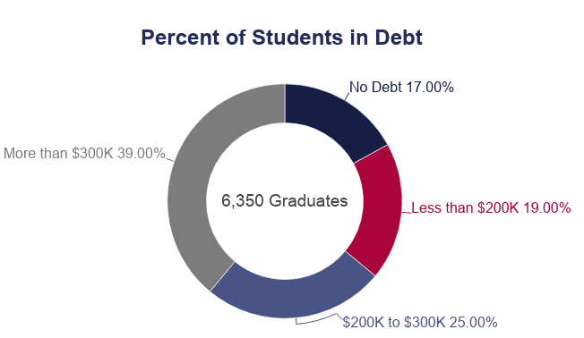
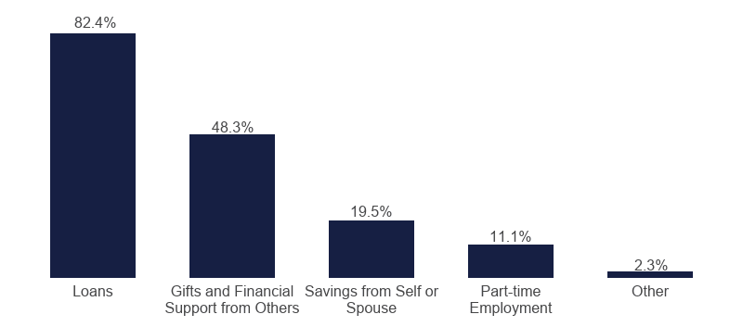
How Dentists Pay For Dental School
educationdata.org/average-dental-school-debt

Slide 11

Average Salary of a Dentist: $212,380
(in the top 10 highest paying states for dentists)
Delaware average dentist salary: $264,440
Alaska average dentist salary: $259,350
Rhode Island average dentist salary: $254,190
Minnesota average dentist salary: $227,280
New Hampshire average dentist salary: $226,300
Connecticut average dentist salary: $213,390
Wisconsin average dentist salary: $213,210
North Dakota average dentist salary: $212,380
North Carolina average dentist salary: $212,160
Nevada average dentist salary: $210,710
The Salary of Dentistry
Notes:
The Wannabe Dentist (thewannabedds.blogspot.com)
*The average time to pay off dental school loans is 10 years.
According to :
credello.com
bankrate.com
Here’s How Much Money Dentists Make In Every State (forbes.com)
Dental Loan Repayment Information | Department of Health (nd.gov)

Slide 12
ND Health Service Corps
STATE
FEDERAL
FEDERAL + STATE
Up to $100,000
5-yr commitment
Accept Medicaid patients
Priority given to dentists working in rural and underserved communities
Up to $50,000/year
2-yr commitment
Must practice at an NHSC approved site with a HPSA score
Up to $25,000/year
2-year commitment with opportunity for continuation
Must practice at a site with a HPSA score
Health professional Shortage Areas (HPSAs)
Notes:
5-yr commitment means agrees to work for at least five years in areas that are defined as “areas of need” in North Dakota Century Code 43-28.1. Priority is given to dentists working in rural and underserved areas that serve Medicaid patients OR practice a public clinic, or a nonprofit dental clinic.
NHSC means National Health Service Corps. This is a government agency that accepts applications for federal student loan repayment programs.
Up to $100,000 means that the program repays up to this amount in student loans in exchange for service in specific dental clinics after graduation.
HPSA score means that the geographic area, population, or facility has a shortage of dental care providers.
The ND Health Service Corps comprises five individual statewide support-for-service effort programs which provide financial support to selected health care providers who work with underserved communities and populations.
North Dakota Health Service Corps | Health and Human Services North Dakota
https://www.health.nd.gov/nd-communities/primary-care-office
https://www.health.nd.gov/nd-communities/primary-care-office/dental-loan-repayment-information

Slide 13
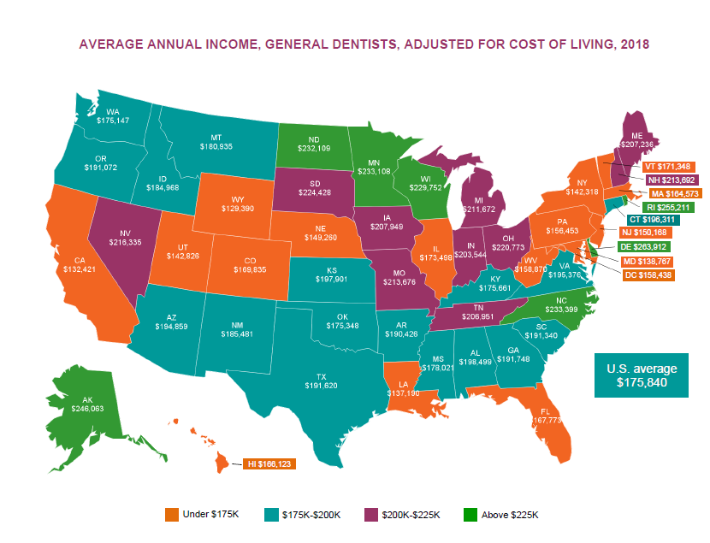
American Dental Association
Notes:
https://www.ada.org/-/media/project/ada-organization/ada/ada-org/files/resources/research/hpi/hpigraphic_0519_1.pdf?rev=c5d77328a7c74b4fa74acd36d1e2d6c1&hash=E04E8000564CF2DA373A73215982876A

Slide 14

First American Indian Dentist
Dr. Rickert was inducted in the Michigan Women’s Hall of Fame for being the first female American Indian dentist in the world.
“I have always wanted to help people, to improve their lives in a meaningful way. I loved math and science and was very good at them. I desired a practical application of my fascination with the biological sciences, and dentistry fulfills that every day. No two patients are ever alike. My own medical doctor encouraged me to pursue medicine or dentistry when I was 12 years old. In college, I decided that dentistry would fit as a career as well as with my personal life goals. I also wanted to be a respected professional in my community.”
Notes:
First American Indian Dentist
Dr. Rickert was inducted in the Michigan Women’s Hall of Fame for being the first female American Indian dentist in the world.
“I have always wanted to help people, to improve their lives in a meaningful way. I loved math and science and was very good at them. I desired a practical application of my fascination with the biological sciences, and dentistry fulfills that every day. No two patients are ever alike. My own medical doctor encouraged me to pursue medicine or dentistry when I was 12 years old. In college, I decided that dentistry would fit as a career as well as with my personal life goals. I also wanted to be a respected professional in my community.”
The Power of Role Models
139-417366113-5.pdf (ne.gov)

Slide 15
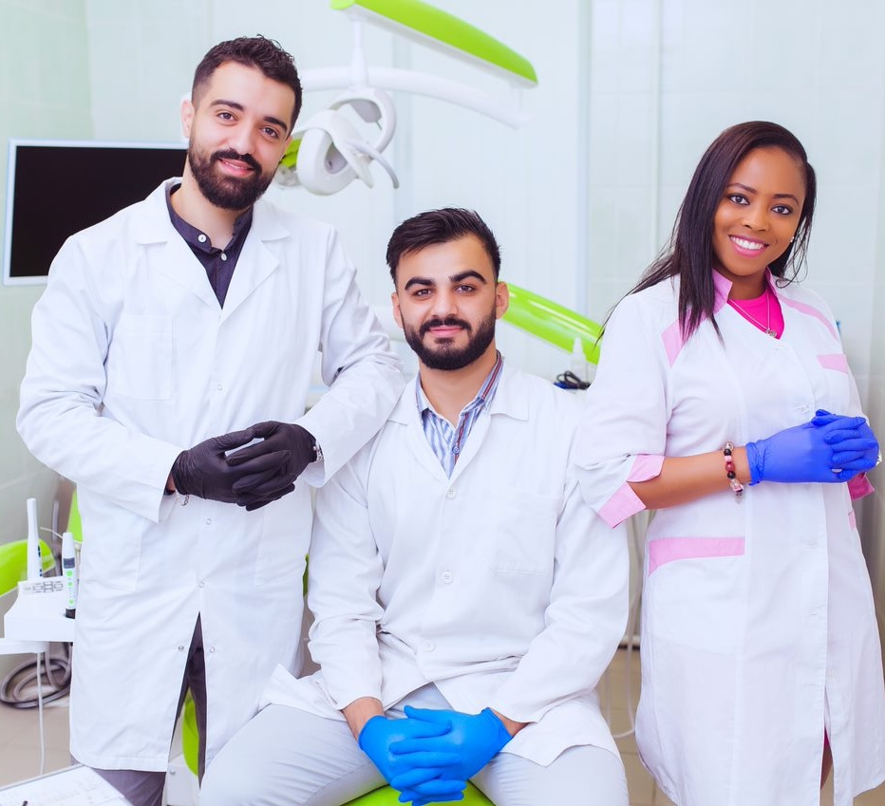
My Story:
Why I Chose Dentistry
Notes:
Add your own photo of you and or your practice

Slide 16

Activity
Notes:
Choose an activity from (add link to website here activities are listed, and checkout form is found)
Option to add own staff personal photo here.

